Slide 1
AAA STRUCTURES &BUILDERS
VELAMMAL COLLEGE OF ENGINEERING AND TECHNOLOGY
Done by
Abieraami S K ( 20CIV01/ 5738D450BA93170A25342968CEDD1FB6)
Abinaya kiruthika V (20CIV02/29989292AF72A39A5C94513F33BE6015)
Aishwarya U (20CIV03/3514D422F79803280AC4CD756BB54414)

Slide 2

LOGO MAKING

Slide 3


Slide 4
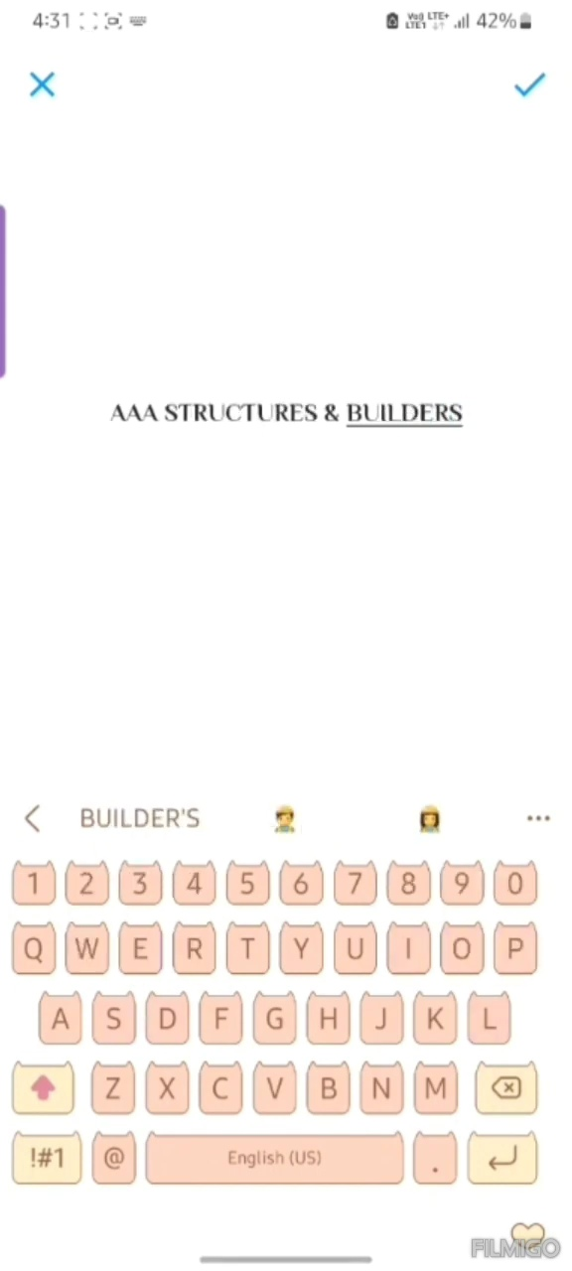

Slide 5


Slide 6


Slide 7


Slide 8


Slide 10


Slide 11
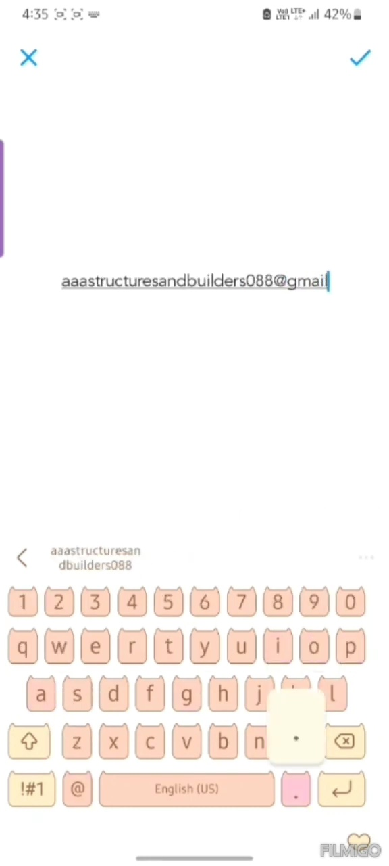

Slide 12


Slide 13


Slide 14
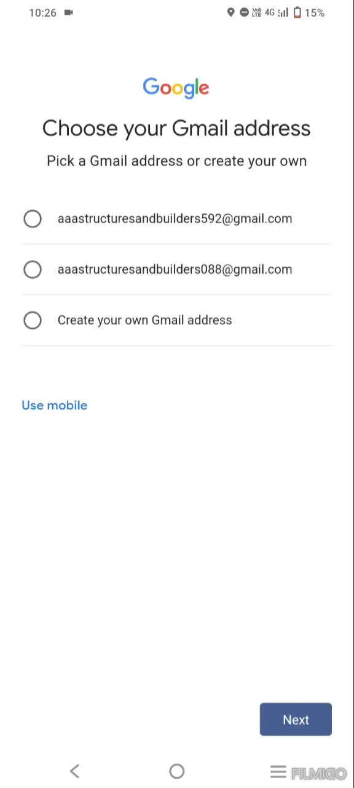

Slide 15
THANK YOU

